Slide 1
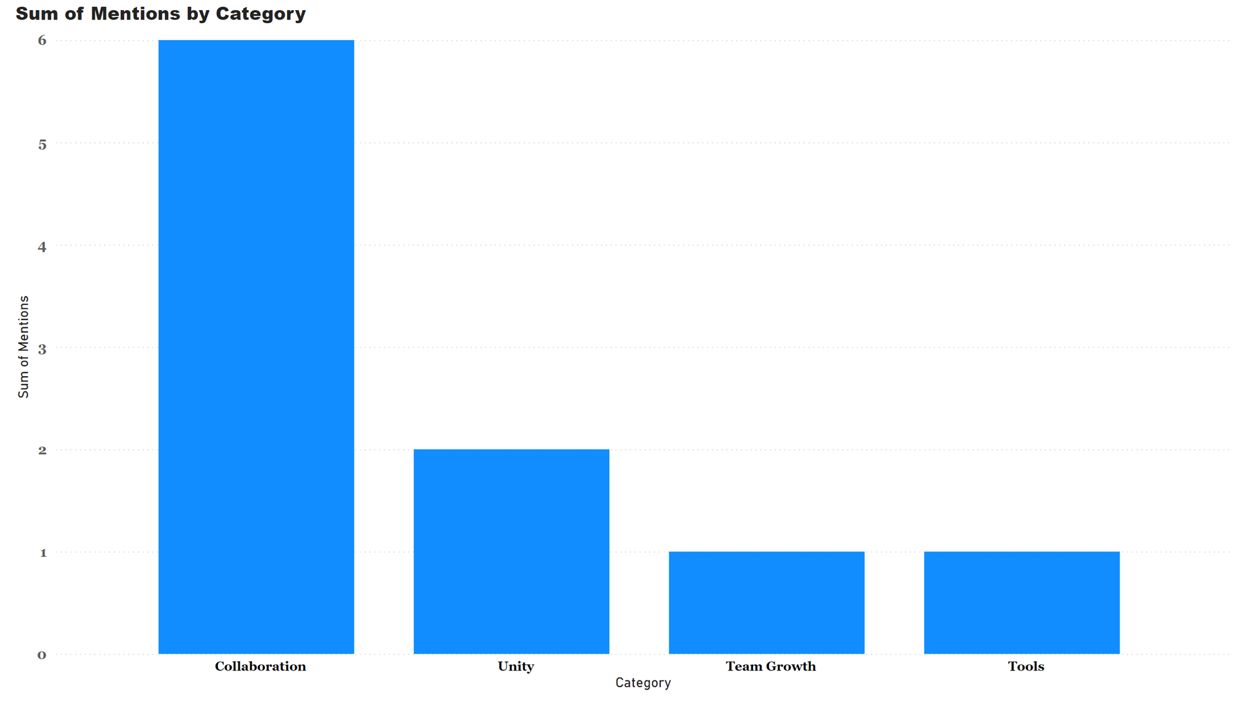
Team Performance Feedback – Sentiment Analysis
Respondents consistently praise the team's collaborative spirit and dedication to shared goals, recognizing that members generally work well together and understand their individual roles.
6 out of 10 reviews specifically mention collaboration as a team strength.
Majority of reviews praise the team culture.

Slide 2
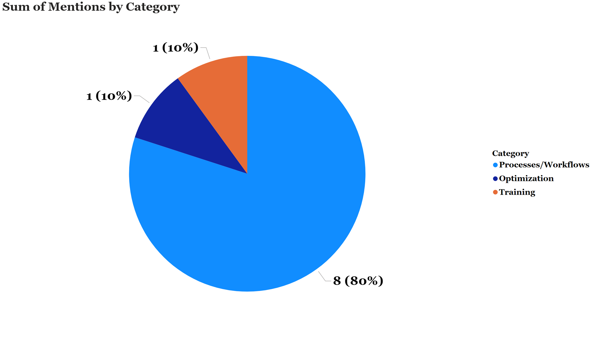
Team Performance Feedback – Sentiment Analysis
However, significant concerns revolve around the lack of clear, consistent processes and communication breakdowns, particularly regarding project tracking, reporting, pricing, and deployment updates.
Based on the analysis of the reviews, multiple concerns were stated in each review though the concern with the highest number of mentions is Processes/Workflows (80% of reviews).
Following concerns about Processes/Workflows, the second most frequent concern is about Optimization and Training (20% of reviews).

Slide 3
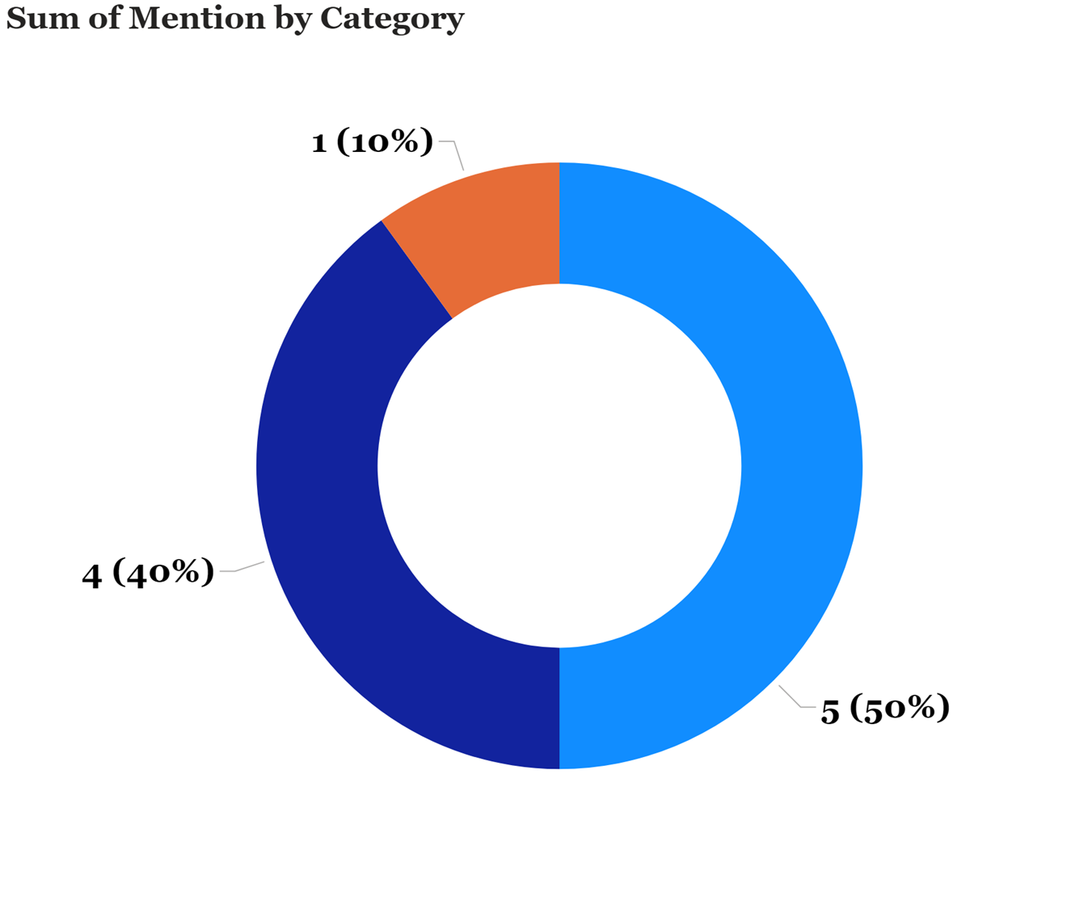
Team Performance Feedback – Sentiment Analysis
Suggestions for improvement include implementing centralized tracking systems, streamlining approval processes, fostering better inter-departmental communication, and providing structured development opportunities for less experienced team members.
Implementing a centralized tracking account for 50% of suggestions
Fostering better inter-departmental communication was mentioned in 4 reviews.
One review mentions streamlining approval processes.

